Slide 1
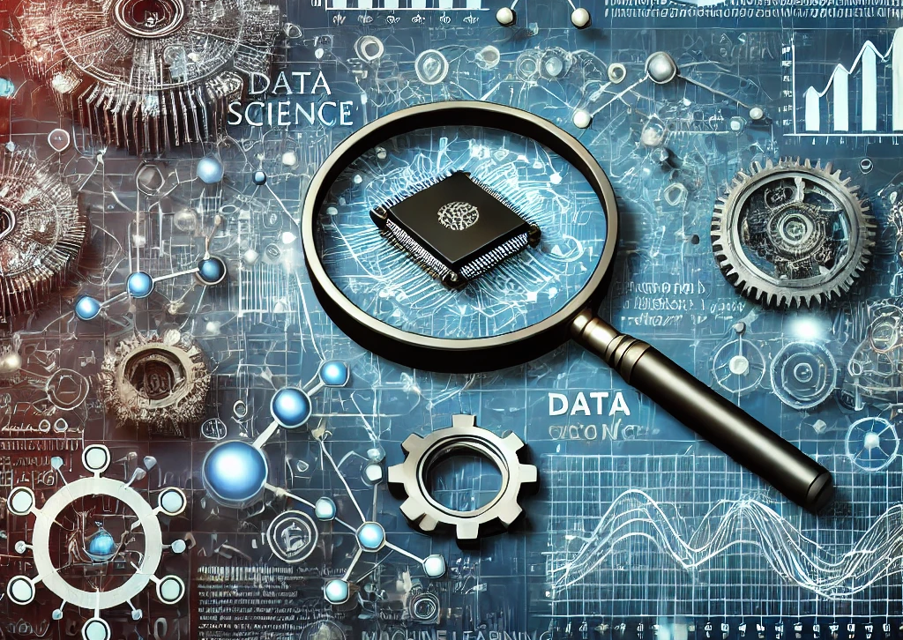
Data Science
Executive Summary
Data Science is an interdisciplinary field focused on extracting insights from data using techniques that combine mathematics, statistics, programming, and domain-specific expertise. It empowers organizations to make data-driven decisions, predict future trends, and optimize processes.
Key Points:
Data Collection & Cleaning: Ensures data is accurate and usable.
Exploratory Data Analysis (EDA): Identifies trends, patterns, and relationships in data.
Modeling & Machine Learning: Creates predictive and prescriptive models for better decision-making.
Impact: Drives efficiency, innovation, and competitive advantages across industries.
Data Science transforms raw data into strategic insights, shaping the future of businesses and society.

Slide 2
Introduction
Project Overview: This project is a comprehensive exploration of data science techniques applied to real-world problems, focusing on data collection, cleaning, exploratory data analysis, and predictive modeling.
Objective: To demonstrate how data-driven methods can extract valuable insights and build predictive models, specifically using a case study on SpaceX Falcon 9 landing success prediction.
Key Components:
Data Collection & Wrangling: Transforming raw data into a structured format.
Exploratory Data Analysis (EDA): Uncovering hidden patterns and relationships.
Predictive Modeling: Developing and evaluating machine learning models to make data-driven predictions.
Visualization & Communication: Creating visual analytics and summarizing findings effectively.
Why This Project Matters: Showcases the end-to-end data science workflow, from data preprocessing to model deployment, with practical applications in aerospace and cost-saving strategies.

Slide 3
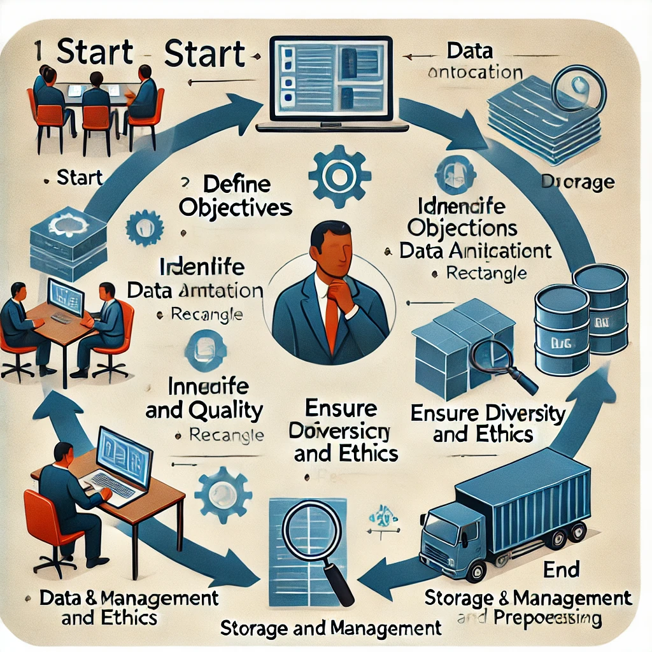
Data Collection
Data collection in the context of images involves gathering visual information for various purposes, such as research, machine learning model training, or analysis. Here’s a detailed explanation:
Steps in Data Collection
Define Objectives:
Determine the purpose of data collection (e.g., training an AI model, conducting research, or analyzing trends).
2. Identify Sources:
Select the sources from which images will be collected. Sources can include:
Public datasets: Existing repositories (like ImageNet, COCO, or Open Images).
Web scraping: Using tools to extract images from websites.
Surveys and user submissions: Collecting images directly from users.
Sensors or cameras: Capturing images in real-time for specific applications.
3. Data Annotation:
Annotate images, if necessary, especially for machine learning. This can include: Labeling objects within images.
Classifying images based on categories.
Providing bounding boxes or segmentation masks.
4. Ensure Diversity and Quality:
Collect a diverse set of images to ensure that the model can generalize well. Check for: Variability in lighting, angles, and backgrounds.
5. Data Privacy and Ethics:
Be mindful of privacy concerns. Ensure compliance with data protection regulations (like GDPR) when collecting images, especially those containing people.
6. Storage and Management:
Organize and store collected images systematically for easy access and analysis. Consider using cloud storage or databases, ensuring efficient retrieval.
7. Preprocessing:
Before using images for analysis or model training, preprocess them to standardize sizes, formats, or enhance quality (e.g., normalization, resizing).

Slide 4

Data Wrangling
Data wrangling, also known as data munging, is the process of cleaning, restructuring, and enriching raw data into a desired format for better analysis. Here’s a general methodology for data wrangling, which can be visually represented in an image format:

Slide 5

Data Wrangling Methodology
1. Data Collection: Gather data from various sources (databases, APIs, web scraping, etc.).
2. Data Exploration: Examine the data to understand its structure, types, and quality. Use descriptive statistics and visualization to identify patterns, trends, and anomalies.
3. Data Cleaning:
Handling Missing Values: Identify and impute or remove missing values.
Removing Duplicates: Check for and eliminate duplicate records.
Correcting Errors: Fix inaccuracies, outliers, or inconsistencies in the data.
4.Data Transformation:
Normalization/Standardization: Scale numerical values to a common range.
Encoding Categorical Variables: Convert categorical data into numerical format (e.g., one-hot encoding).
Feature Engineering: Create new variables based on existing data to enhance model performance.

Slide 6

Data Wrangling Methodology
5. Data Integration: Combine data from multiple sources into a single dataset, ensuring consistency and coherence.
6. Data Formatting: Convert data into the required format (e.g., CSV, JSON) for analysis or machine learning tasks.
7. Data Validation: Verify that the transformed data meets the quality standards and is suitable for analysis.
8. Data Documentation: Document the data wrangling process, including decisions made and methods used for future reference.

Slide 7

EDA and Interactive Visual Analytics Methodology
Define Objectives:
Determine the goals of the analysis.
Identify key questions that need answering.
Data Collection:
Gather relevant datasets from various sources.
Ensure data is collected in a format suitable for analysis.
Data Cleaning:
Handle missing values (impute, remove, etc.).
Identify and rectify inconsistencies or errors in the data.
Remove duplicates and irrelevant features.
Data Exploration:
Univariate Analysis: Analyze individual variables using summary statistics (mean, median, mode, etc.) and visualizations (histograms, box plots).
Bivariate Analysis: Investigate relationships between two variables using scatter plots, correlation matrices, and cross-tabulations.
Multivariate Analysis: Examine interactions among multiple variables using techniques like pair plots, heatmaps, and 3D visualizations.

Slide 8
EDA and Interactive Visual Analytics Methodology
Data Visualization:
Create visual representations of data to identify patterns, trends, and anomalies.
Use various visualization tools (e.g., Matplotlib, Seaborn, Tableau) to produce graphs and charts.
Interactive Analysis:
Implement interactive visualizations (using tools like Plotly, D3.js, or Tableau) that allow users to explore the
data dynamically.
Enable filtering, zooming, and hovering capabilities to facilitate deeper insights.
Hypothesis Testing:
Formulate and test hypotheses based on insights gained from EDA.
Utilize statistical tests to validate findings and assess the significance of relationships.
Documentation and Reporting:
Document findings, visualizations, and insights in a clear and concise manner.
Prepare reports or presentations to communicate results to stakeholders.
Iterate and Refine:
Based on feedback, revisit earlier steps to refine analysis or explore new questions.
Continuously improve visualizations and analytics based on user interaction and feedback.

Slide 9

Predictive Analysis Methodology
Predictive analysis involves using statistical techniques, machine learning, and data mining to analyze historical data and predict future outcomes. Here's a structured methodology for conducting predictive analysis:

Slide 10

Predictive Analysis Methodology
Define the Problem:
Identify the business or research question to be addressed.
Clearly define the target variable (what you want to predict) and the desired outcomes.
Data Collection:
Gather relevant data from various sources (databases, surveys, APIs, etc.).
Ensure the data collected is comprehensive and of high quality.
Data Preprocessing:
Data Cleaning: Handle missing values, remove duplicates, and correct inaccuracies.
Data Transformation: Convert data into suitable formats (e.g., normalizing, encoding categorical variables).
Feature Selection: Identify the most relevant features that contribute to the predictive model.
Exploratory Data Analysis (EDA):
Conduct EDA to understand the data distribution and relationships between variables.
Visualize data using charts and graphs to identify trends and patterns.

Slide 11
Predictive Analysis Methodology
Model Selection:
Choose appropriate predictive modeling techniques based on the nature of the problem (regression,
classification, time series forecasting, etc.).
Consider various algorithms (e.g., linear regression, decision trees, random forests, neural networks)
for implementation.
Model Training:
Split the dataset into training and testing sets.
Train the selected model on the training dataset.
Fine-tune model parameters to optimize performance.
Model Evaluation:
Evaluate the model's performance using the testing dataset.
Use metrics such as accuracy, precision, recall, F1 score, RMSE, or R² to assess model effectiveness.
Conduct cross-validation to ensure robustness.
Model Deployment:
Implement the model in a production environment for real-time predictions or batch processing.
Ensure that the deployment includes monitoring and maintenance plans.

Slide 12

Predictive Analysis Methodology
Model Monitoring and Maintenance:
Continuously monitor model performance and accuracy over time.
Update the model as necessary to accommodate changes in data patterns or business requirements.
Reporting and Communication:
Document the predictive analysis process, findings, and insights.
Communicate results effectively to stakeholders through reports or presentations.

Slide 13
EDA Methodology with Visualization Results
Exploratory Data Analysis (EDA) with visualization is a crucial step in understanding your dataset and uncovering patterns, trends, and anomalies. Here’s a structured approach to conducting EDA along with visualization results that can help in interpreting the findings:

Slide 14
EDA Methodology with Visualization Results
Define the Objective:
State the specific questions or hypotheses you want to investigate.
Data Collection:
Collect the relevant dataset(s) and ensure data quality.
Data Cleaning:
Handle missing values (imputation or removal).
Correct inconsistencies and remove duplicates.
Univariate Analysis:
Analyze individual variables.
Visualization Techniques:
Histograms: Show the distribution of numerical variables.
Box Plots: Identify outliers and visualize the spread of the data.
Bar Charts: Visualize categorical variables and their frequencies.

Slide 15
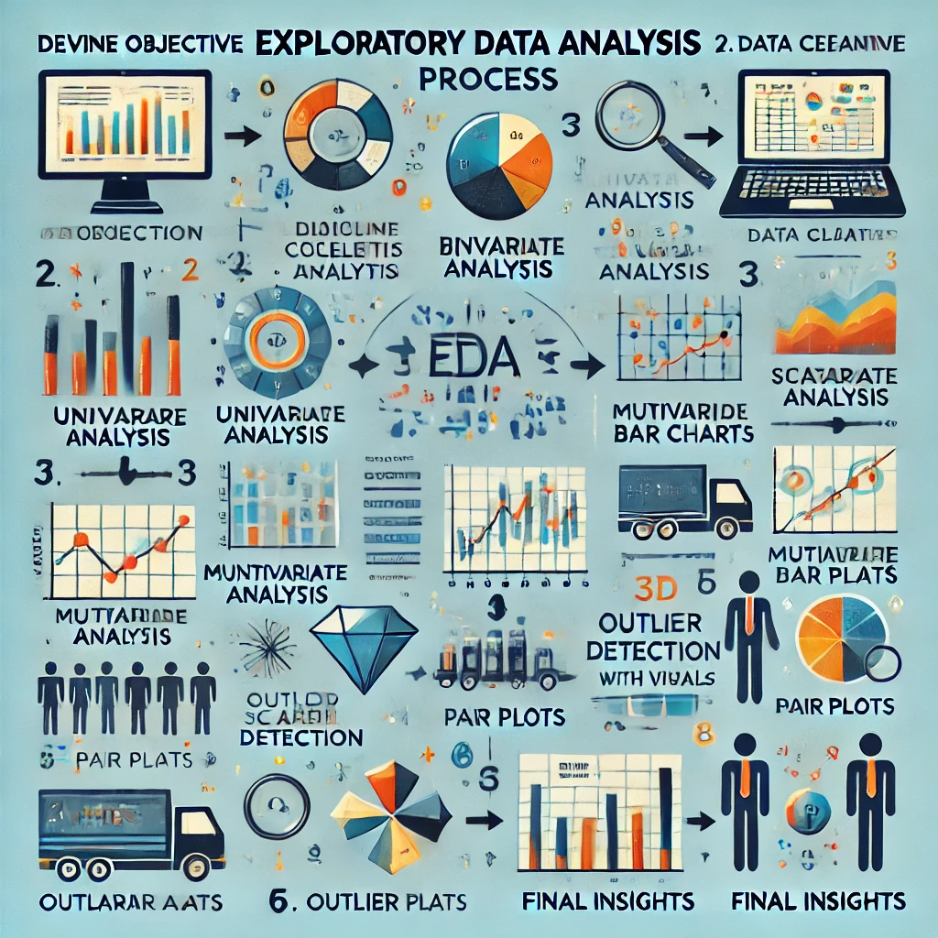
EDA Methodology with Visualization Results
Bivariate Analysis:
Examine relationships between two variables.
Visualization Techniques:
Scatter Plots: Reveal relationships between two numerical variables.
Heatmaps: Display correlations between multiple numerical variables.
Example Visualization Results:
Scatter Plot: Illustrates the correlation between hours studied and exam scores.
Heatmap: Shows correlation coefficients between different features in the dataset.
Grouped Bar Chart: Compares sales across different product categories and regions.
Multivariate Analysis:
Explore interactions among three or more variables.
Visualization Techniques:
Pair Plots: Visualize pairwise relationships in the dataset.
3D Scatter Plots: Show three-dimensional relationships between three variables.
Example Visualization Results:
Pair Plot: Displays relationships between multiple features with different colors for different classes.
3D Scatter Plot: Visualizes the interaction between three continuous variables.
Facet Grid: Shows sales trends over time across different regions or categories.
Outlier Detection:
Identify and visualize outliers in the dataset.
Visualization Techniques:
Box Plots: Useful for highlighting outliers.
Scatter Plots: Identify outliers in relation to other variables.
Final Insights:
Summarize findings from the EDA process.
Highlight key patterns, trends, and insights discovered through visualizations.

Slide 16
EDA with SQL results
Exploratory Data Analysis (EDA) with SQL involves using SQL queries to extract insights from a dataset. Here’s a general approach to performing EDA using SQL, along with some example queries that can help you analyze the data:

Slide 17
EDA with SQL results
1. Understand Your Data
Query to Get the Structure of the Table:
DESCRIBE table_name;
Query to Count Total Rows:
SELECT COUNT(*) FROM table_name;
2. Summary Statistics
Query for Basic Descriptive Statistics:
SELECT
AVG(column_name) AS average,
MIN(column_name) AS minimum,
MAX(column_name) AS maximum,
COUNT(DISTINCT column_name) AS unique_values
FROM table_name;

Slide 18
EDA with SQL results
Query for Count of Each Category:
SELECT
category_column,
COUNT(*) AS count
FROM table_name
GROUP BY category_column
ORDER BY count DESC;
3. Check for Missing Values
Query to Count Null Values:
SELECT
COUNT(*) - COUNT(column_name) AS missing_values
FROM table_name;

Slide 19
EDA with SQL results
4. Data Distribution
Query for Histogram-like Distribution:
SELECT
column_name,
COUNT(*) AS frequency
FROM table_name
GROUP BY column_name
ORDER BY column_name;
5. Relationships Between Variables
SELECT
CORR(column1, column2) AS correlation
FROM table_name;

Slide 20
Interactive map with Folium results
Creating interactive map slides using Folium can be a great way to present geographical data in your project. Here’s a simple structure for how you might organize your slides and what content to include:

Slide 21
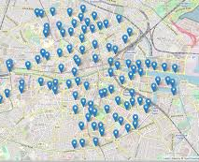
Introduction to Folium
Brief introduction to Folium and its capabilities.
Explain why interactive maps are useful for visualizing data (e.g., geographical trends, distributions).

Slide 22
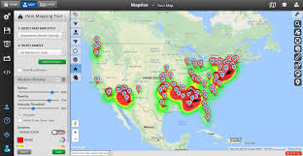
Key Features of Folium
Interactive maps with markers and popups.
Support for various tile layers (OpenStreetMap, Stamen Terrain, etc.).
Ability to visualize heatmaps and choropleth maps.
Easy integration with Jupyter notebooks and Python environments.

Slide 23
Example Code and Output
Provide a code snippet demonstrating how to create a simple map with Folium
import folium
# Create a base map
map_center = [latitude, longitude]
my_map = folium.Map(location=map_center, zoom_start=10)
# Add a marker
folium.Marker(
location=[latitude, longitude],
popup='Location Name',
icon=folium.Icon(color='blue')
).add_to(my_map)
# Display the map
my_map.save('map.html')

Slide 24
Plotly Dash Dashboard
Creating a Plotly Dash dashboard can effectively visualize and interact with your data. Here’s a general guide on how to structure the results for your dashboard, including key components you might want to highlight.

Slide 25
Dashboard Structure
Title and Overview
Title: Title of Your Dashboard (e.g., "Sales Data Dashboard")
Overview: Brief description of what the dashboard is tracking or analyzing (e.g., trends over time, sales by category).
Key Metric:
Example: html.Div([
html.H3('Total Sales: $500,000'),
html.H3('Average Sales: $50,000'),
html.H3('Number of Transactions: 10,000')
])

Slide 26
Dashboard Structure
Graphs and Charts
Time Series Graph: Show sales over time
dcc.Graph(
id='time-series-chart',
figure={
'data': [
{'x': ['January', 'February', 'March'], 'y': [20000, 30000, 50000], 'type': 'line', 'name': 'Sales'},
],
'layout': {
'title': 'Sales Over Time'
}
}
)

Slide 27
Dashboard Structure
Bar Chart: Visualize sales by category
dcc.Graph(
id='category-bar-chart',
figure={
'data': [
{'x': ['Category A', 'Category B', 'Category C'], 'y': [150000, 200000, 250000], 'type': 'bar'},
],
'layout': {
'title': 'Sales by Category'
}
}
)

Slide 28
Dashboard Structure
Interactivity
Dropdowns and Sliders: Allow users to filter data based on categories or time periods.
dcc.Dropdown(
id='category-filter',
options=[
{'label': 'Category A', 'value': 'A'},
{'label': 'Category B', 'value': 'B'},
{'label': 'Category C', 'value': 'C'}
],
value='A'
)

Slide 29
Dashboard Structure
Conclusion and Insights
Summarize key insights derived from the dashboard, such as:
Trends in sales over the last few months.
Categories contributing the most to overall sales.
Recommendations based on data insights.

Slide 30
Example Code for a Basic Dash App
import dash
from dash import dcc, html
import plotly.graph_objs as go
app = dash.Dash(__name__)
app.layout = html.Div([
html.H1('Sales Data Dashboard'), html.Div(id='key-metrics', children=[ html.H3('Total Sales: $500,000'), html.H3('Average Sales: $50,000'), html.H3('Number of Transactions: 10,000') ]),
dcc.Graph(
id='time-series-chart’,
figure={
'data': [
go.Scatter(x=['January', 'February', 'March'], y=[20000, 30000, 50000], mode='lines+markers', name='Sales') ], 'layout': { 'title': 'Sales Over Time' } } ),
dcc.Graph(
id='category-bar-chart’,
figure={
'data': [
go.Bar(x=['Category A', 'Category B', 'Category C'], y=[150000, 200000, 250000]) ],
'layout': { 'title': 'Sales by Category' } } ) ]) if __name__ == '__main__': app.run_server(debug=True)

Slide 31
Predictive analysis
Predictive analysis, particularly classification, involves using historical data to train models that can classify new data points into categories. Here are some common results and metrics you might encounter in predictive classification analysis:
Confusion Matrix: This is a table used to describe the performance of a classification model. It shows the number of true positive, false positive, true negative, and false negative predictions.
Accuracy: This is the ratio of correctly predicted instances to the total instances. It is calculated as:
Accuracy=True Positives+True NegativesTotal Instances\text{Accuracy} = \frac{\text{True Positives} + \text{True Negatives}}{\text{Total Instances}}Accuracy=Total InstancesTrue Positives+True Negatives
Precision: This measures the accuracy of positive predictions. It is defined as:
Precision=True PositivesTrue Positives+False Positives\text{Precision} = \frac{\text{True Positives}}{\text{True Positives} + \text{False Positives}}Precision=True Positives+False PositivesTrue Positives

Slide 32
Predictive analysis
Recall (Sensitivity): This measures the ability of a model to find all the relevant cases (i.e., positive instances). It is calculated as:
Recall=True PositivesTrue Positives+False Negatives\text{Recall} = \frac{\text{True Positives}}{\text{True Positives} + \text{False Negatives}}Recall=True Positives+False NegativesTrue Positives
F1 Score: This is the harmonic mean of precision and recall, providing a balance between the two:
F1=2×Precision×RecallPrecision+RecallF1 = 2 \times \frac{\text{Precision} \times \text{Recall}}{\text{Precision} + \text{Recall}}F1=2×Precision+RecallPrecision×Recall
ROC Curve: The Receiver Operating Characteristic curve is a graphical representation of the trade-off between the true positive rate and the false positive rate at various threshold settings.
AUC (Area Under the Curve): This metric provides a single measure of overall accuracy that can be understood intuitively. It represents the probability that a randomly chosen positive instance is ranked higher than a randomly chosen negative one.
Cross-Validation Results: When using techniques like k-fold cross-validation, you’ll see average metrics across different subsets of the dataset, which helps assess the model’s robustness.
Feature Importance: In many models (like decision trees or ensemble methods), you can obtain insights into which features (variables) are most important for classification.
Misclassification Rate: This is the proportion of instances that were incorrectly classified, calculated as:
Misclassification Rate=False Positives+False NegativesTotal Instances\text{Misclassification Rate} = \frac{\text{False Positives} + \text{False Negatives}}{\text{Total Instances}}Misclassification Rate=Total InstancesFalse Positives+False Negatives

Slide 33
Conclusion
Course Impact:
Prepared for Real-World Data Challenges: Equipped with the ability to approach and solve complex data problems.
Industry-Relevant Tools: Experience with platforms and libraries such as Pandas, Scikit-learn, and TensorFlow.
Collaborative Learning: Engaged with peers in project reviews and discussions, fostering a community learning experience.
Key Skills Gained:
Programming in Python/R
Building predictive models
Data visualization and storytelling
Model evaluation and tuning

